Slide 1
Geek Squad Home Membership Plan UX vision Design Sprint
Digital Experience & Usability

Slide 2
1
2
3
4
Design Sprint Goals
UX Themes for GSHM
Sprint User Testing Results
Next Steps
Notes:
1. Design Sprint Goals
2. UX Themes for GSHM
3. Sprint User Testing Results
4. Next Steps

Slide 3
GOALS

Slide 4
DESIGN SPRINT GOALS
GOAL 1 Get an overview of the Geek Squad Home Membership Plan UX vision in a total retail setting
GOAL 2 Conduct a test on a component of that vision to validate

Slide 5
UX THEMES FOR GSHM
1
2
3
Everyone is a Member
Personalized value
Easy access is great promotion
4
5
Simple to reach agents
Provide a plan
Notes:
Themes are mapped to examples and the user journey

Slide 6
EVERYONE IS A MEMBER

Slide 7
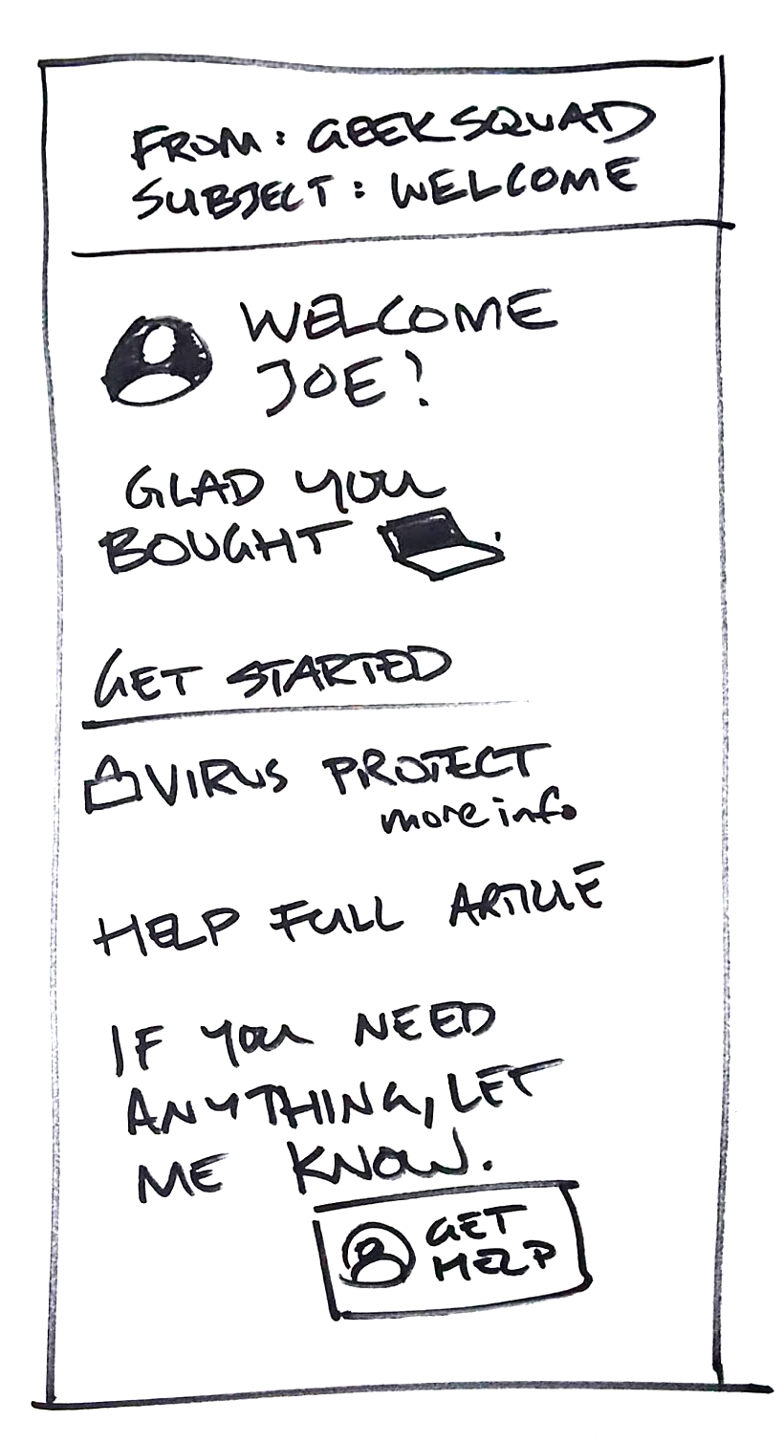



UX THEMES
EVERYONE IS A MEMBER: WELCOME EVERYONE
Customer purchases a laptop
Gets notified by GS offering tips and to help

Slide 8
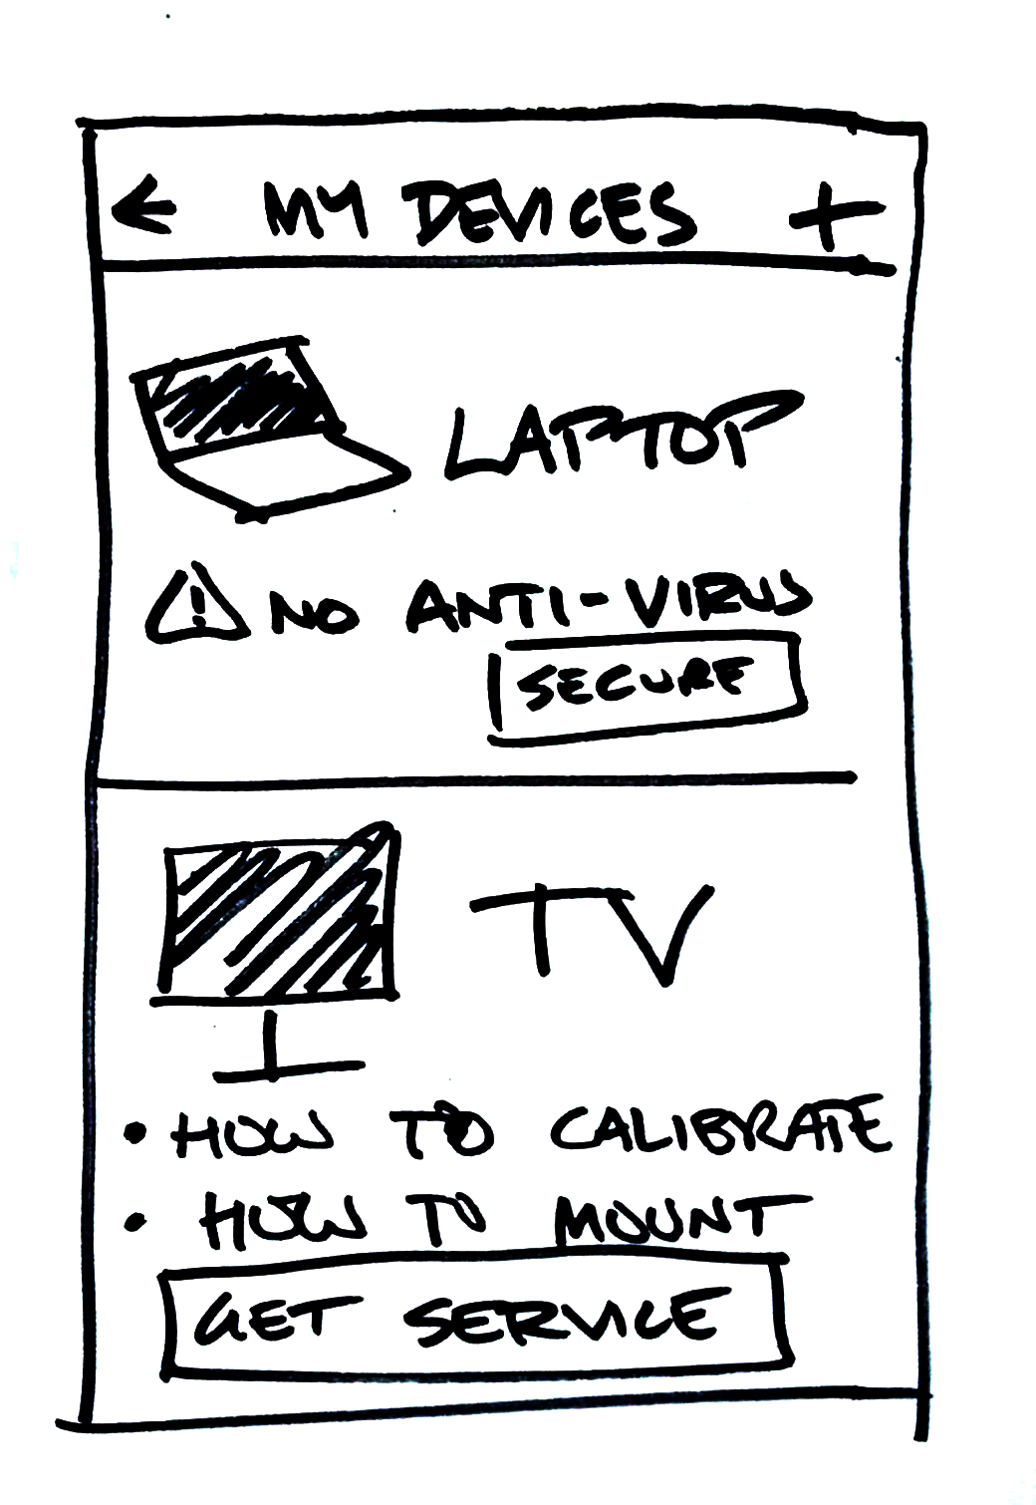

UX THEMES
EVERYONE IS A MEMBER: MY DEVICES
My Devices:
Customer can always go back and see relevant help and services for the products he has purchased.
A device-based view is better for this than order history, which is based on transactions.

Slide 9
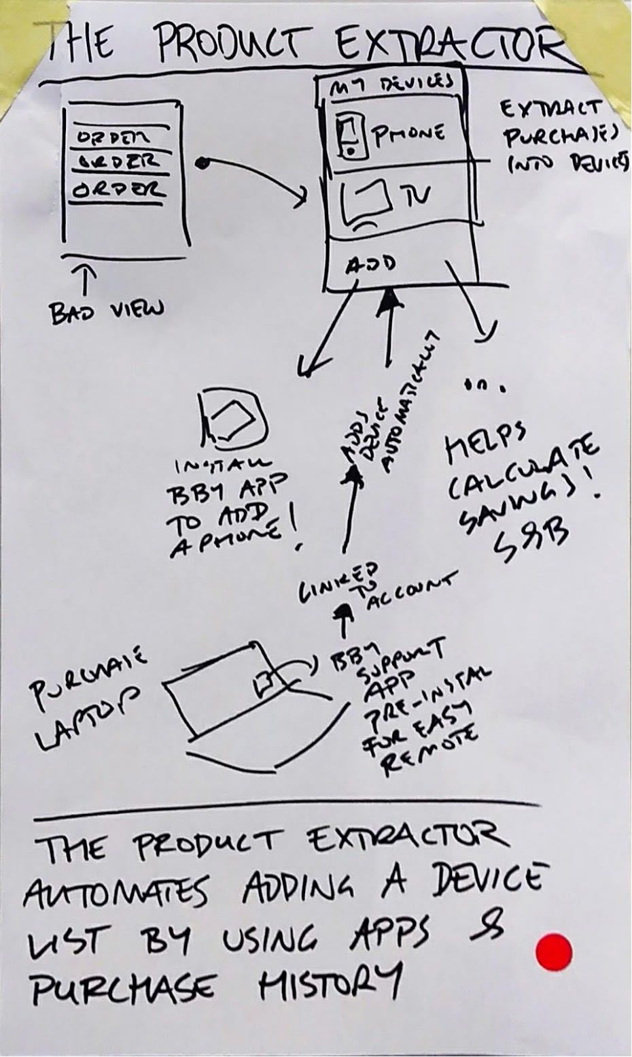
UX THEMES
EVERYONE IS A MEMBER
Everyone is a member
When you buy from Best Buy you’re initiating a Geek Squad relationship
Friendly and on-brand, lessens divide between member and non-member
Widen funnel at the mouth
Emphasis on automation and easy access for adding product: My devices view that makes it easy to find (or add, remove) products

Slide 10
PERSONALIZED VALUE

Slide 11
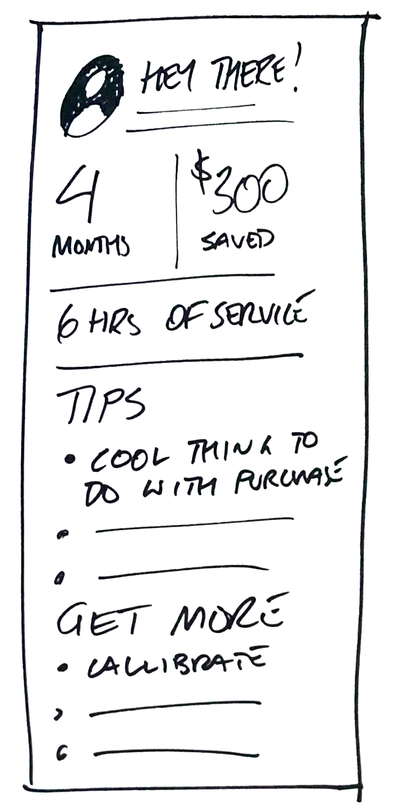


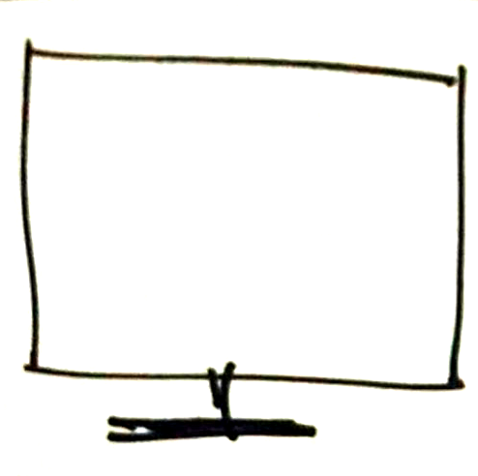
UX THEMES
PERSONALIZED VALUE: MEMBER REPORT
Member buys TV
Gets it installed
Receives quarterly report with
Money saved
Hours of service received
Related perks and services
Notes:
Paid members are provided with reports that outline the benefits claimed as well as key benefits for that customer

Slide 12
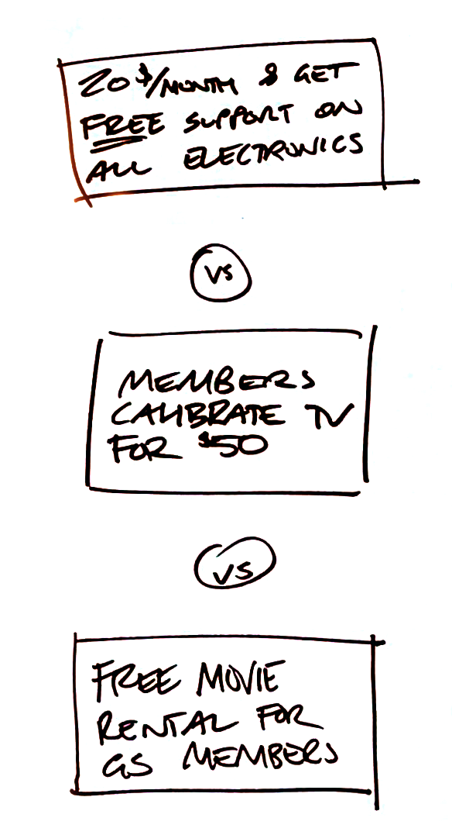
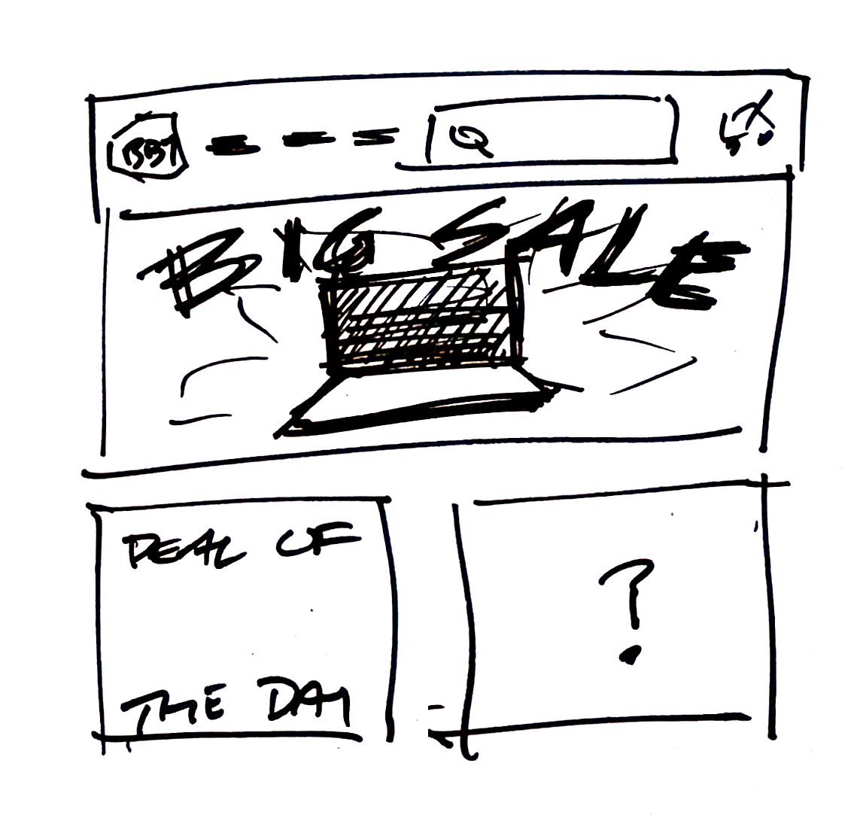

UX THEMES
PERSONALIZED VALUE: PERSONALIZED SERVICE OFFERS
Personalize service offers based on purchase for anyone arriving to the site.
Notes:
Each of these messages can have a receptive items. If we know your purchases, we can give you the right one.
All members

Slide 13
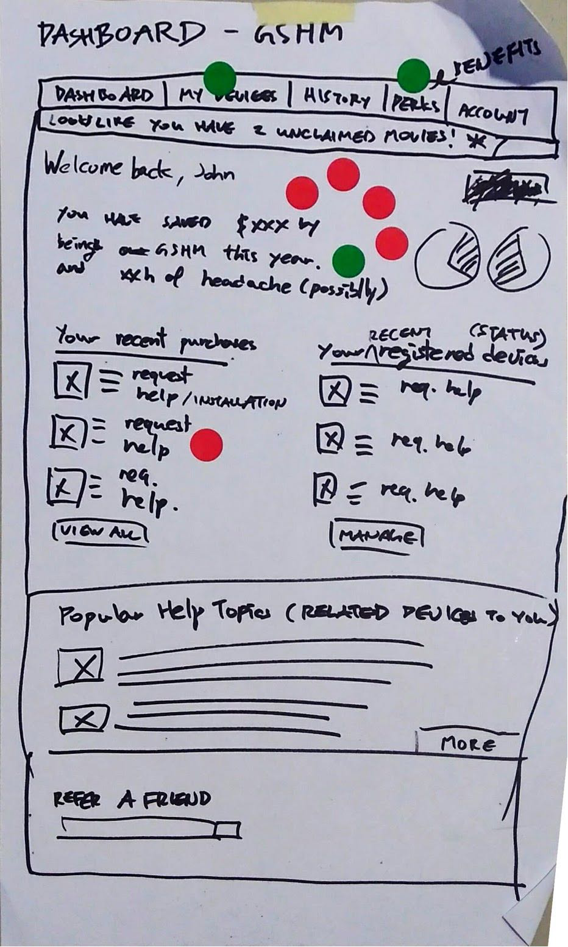
UX THEMES
PERSONALIZED VALUE
Personalized value
Communicate value of plan, savings and available perks
Early access to sales or reserved inventory
Proactively calculate value paid membership would give to Best Buy customers – based on their purchases

Slide 14
EASY ACCESS IS GREAT PROMOTION

Slide 15
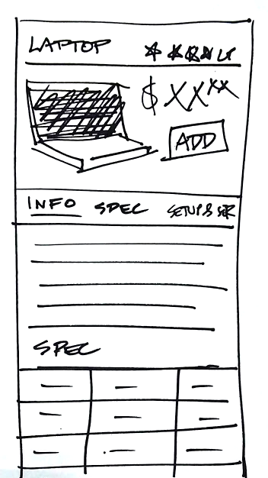
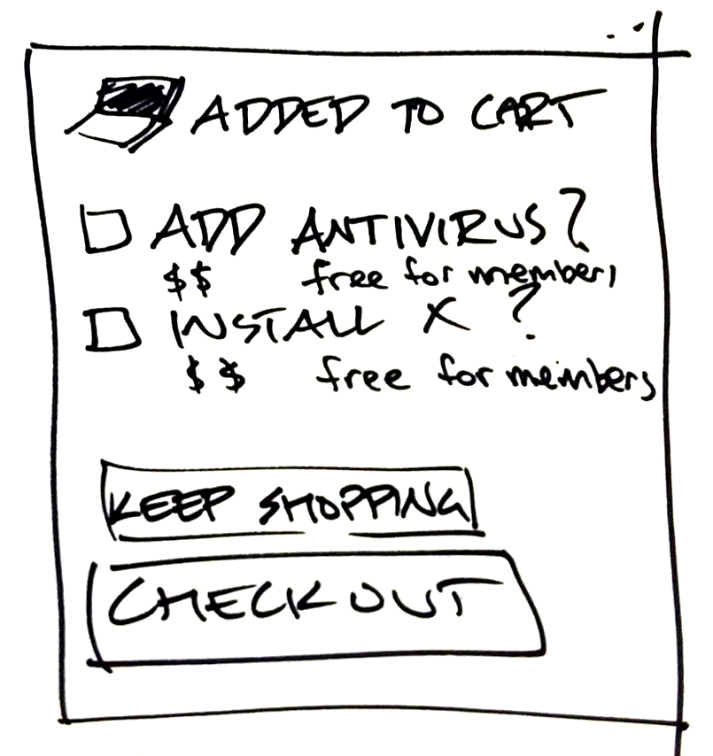
UX THEMES
EASY ACCESS IS GREAT PROMOTION: BUILT-IN SETUP
I should get this… how can I become a member?
Anyone shopping can configure and customize their purchase. Free callout to members.
Oh cool, it’s free
Notes:
Describe flow better. Set up scenario.

Slide 16
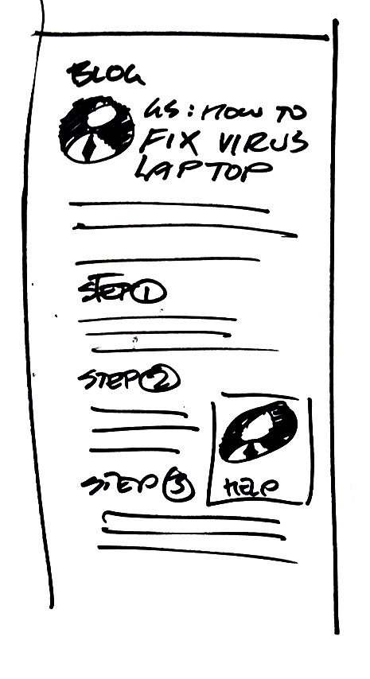
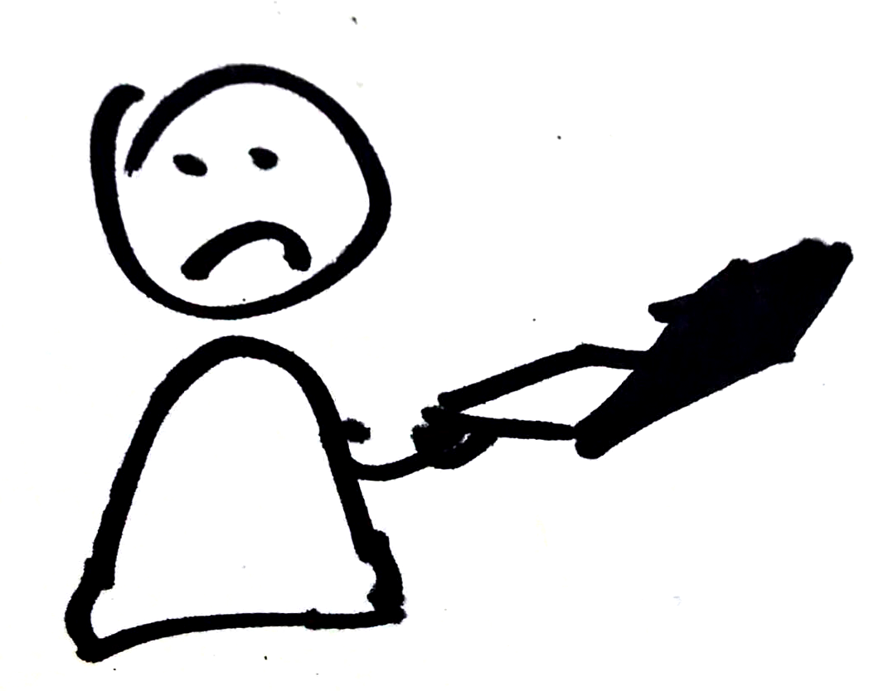

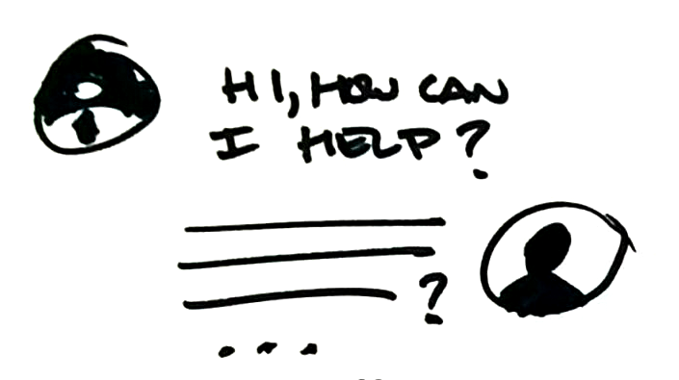

UX THEMES
EASY ACCESS IS GREAT PROMOTION: CONTENT TO MEMBERSHIP
Notes:
More text explaining, use a scenario. Google virus. Show path.

Slide 17

UX THEMES
EASY ACCESS IS GREAT PROMOTION: CONTENT TO MEMBERSHIP
Great, thanks for your help, that was easy.
GS: I have to connect to your machine.
I can pay one time for help OR I can become a member
Notes:
More text explaining, use a scenario. Google virus. Show path.

Slide 18
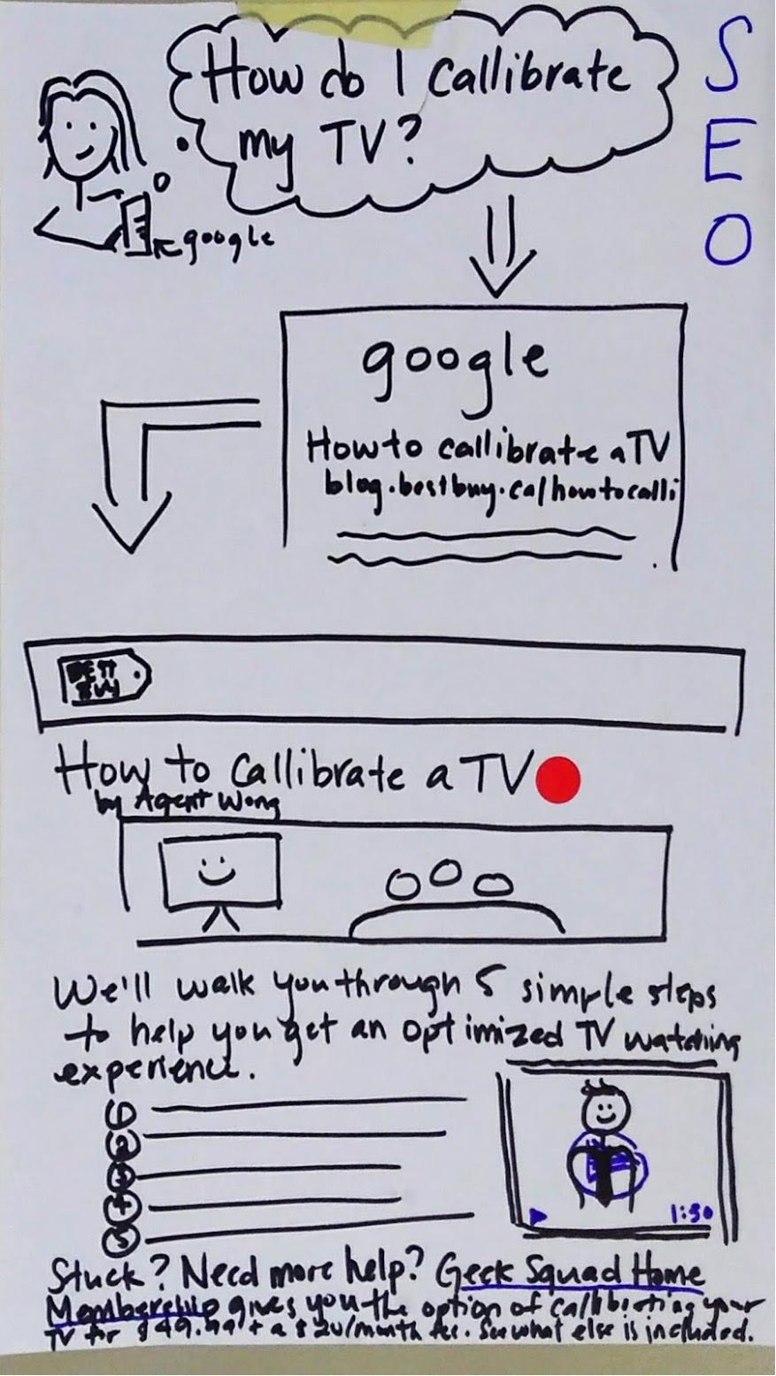
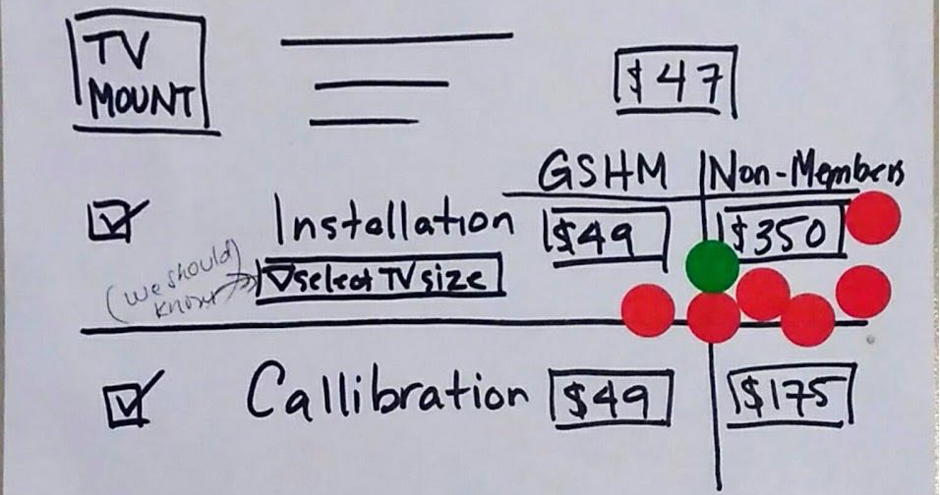
Easy access is great promotion
If benefits of paid membership are integrated into the funnel, then they are visible to all customers, who can perceive the value as a whole.
Troubleshooting and seeking help is a service moment of truth
Provide free help content for all. Allow to ask questions, and sell service as needed.

Slide 19
SIMPLE TO REACH AGENTS ON ALL PLATFORMS

Slide 20
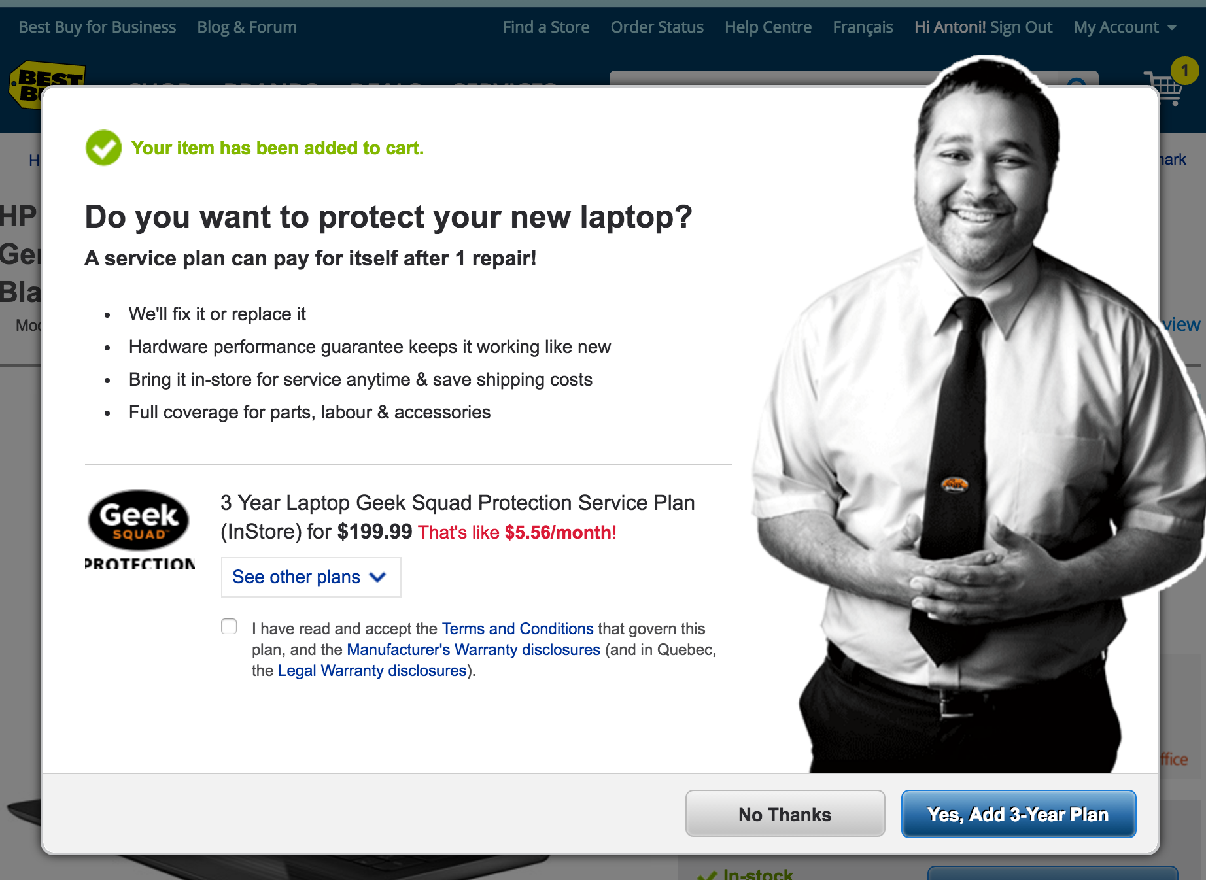
SERVICE UX THEMES
SIMPLE TO REACH AGENTS
Helps establish a conversational style
Notes:
- Purchase story

Slide 21

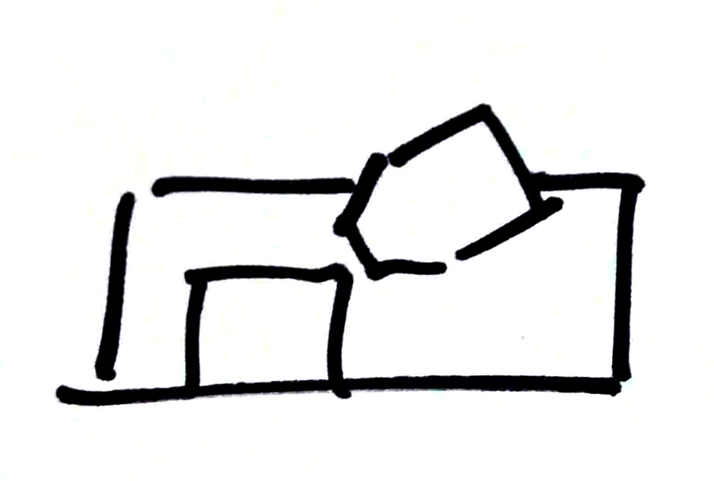
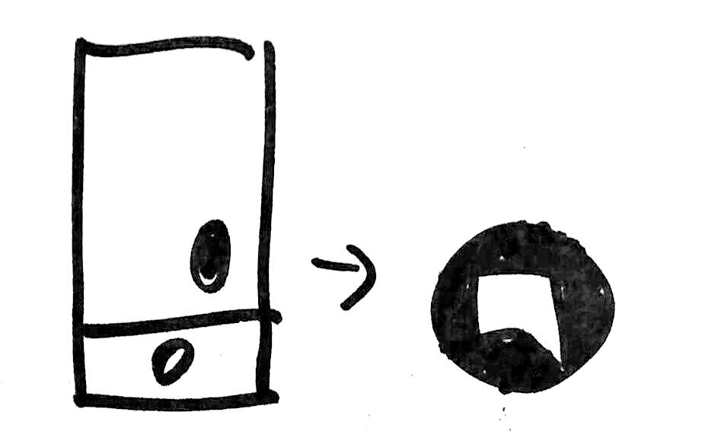

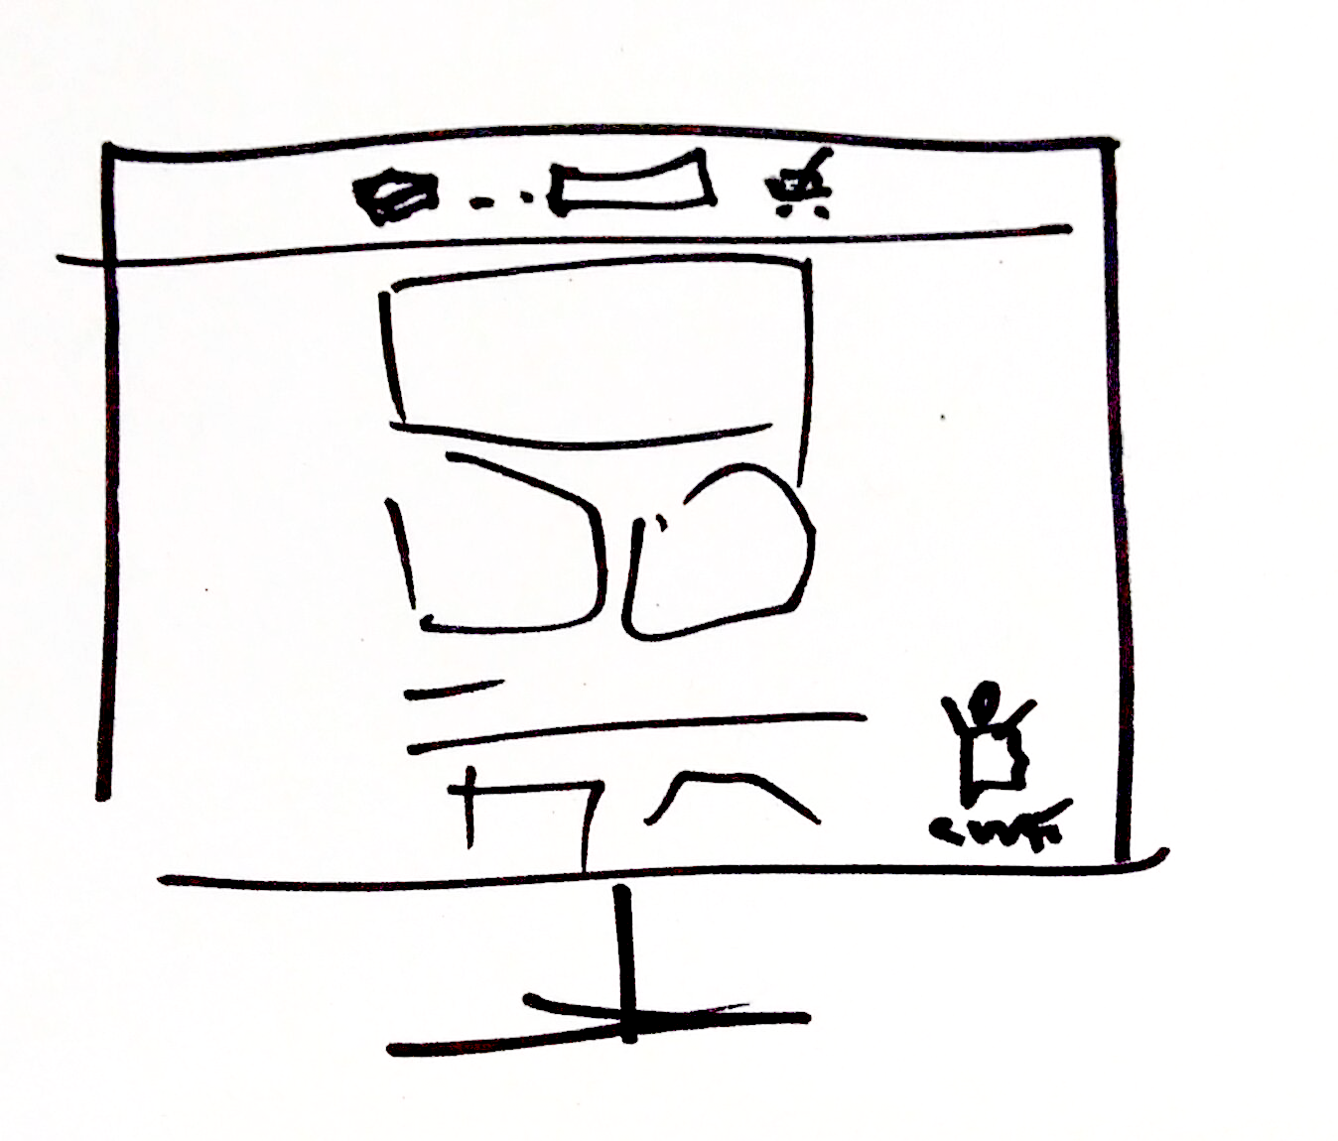

SERVICE UX THEMES
SIMPLE TO REACH AGENTS
Hi, can I help you?
Hello, I’m bookapointment bot. Would you like to wait for a human?
Contacting an associate should be as similar an experience as possible, and leverage each channel.
Notes:
- Purchase story

Slide 22
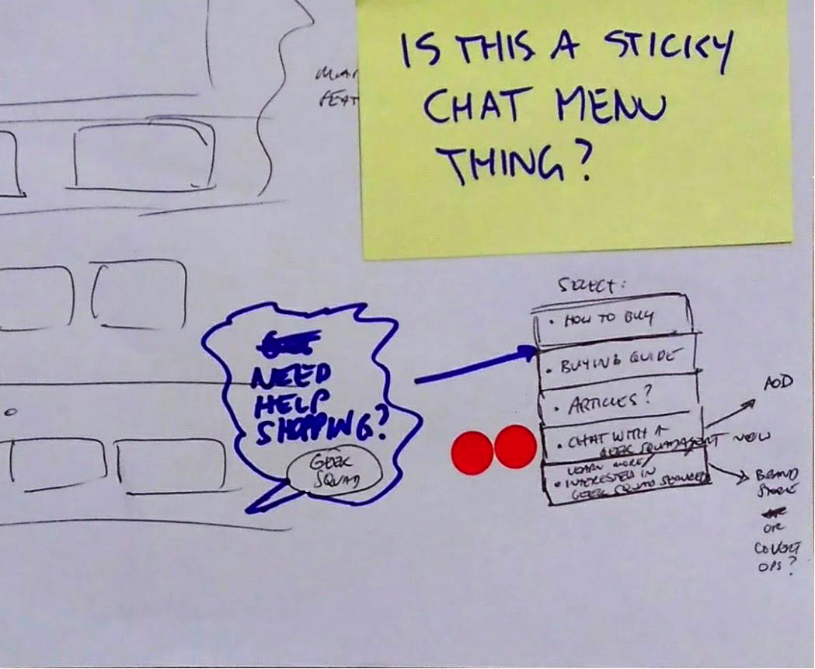
SERVICE UX THEMES
SIMPLE TO REACH AGENTS
SIMPLE TO REACH AGENTS
Geek Squad services have some of the company’s highest NPS scores (85 as of May 2017)
Use local associates for last communications before service to potentially build the relationship.
Dealing with a person is the asset for some customers, especially for support
Notes:
- Purchase story

Slide 23
PROVIDE A PLAN

Slide 24
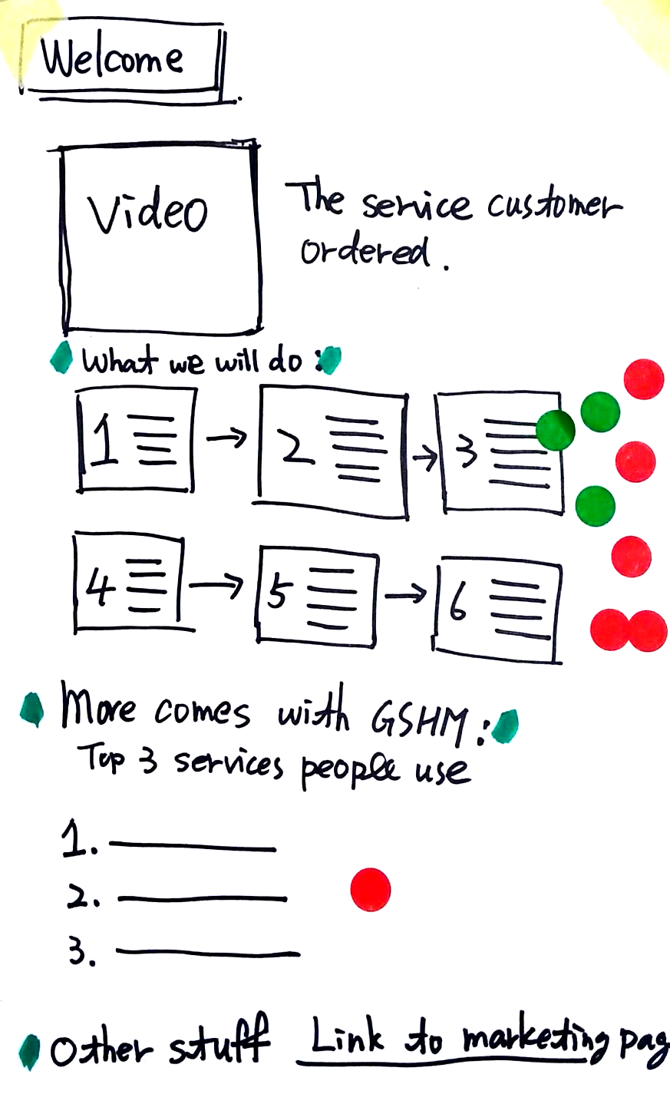
SERVICE UX THEMES
PROVIDE A PLAN
Anyone buying a TV and service gets a detailed plan of what the service will entail.
This creates a sense of organization and sets expectations
Notes:
- Purchase story

Slide 25
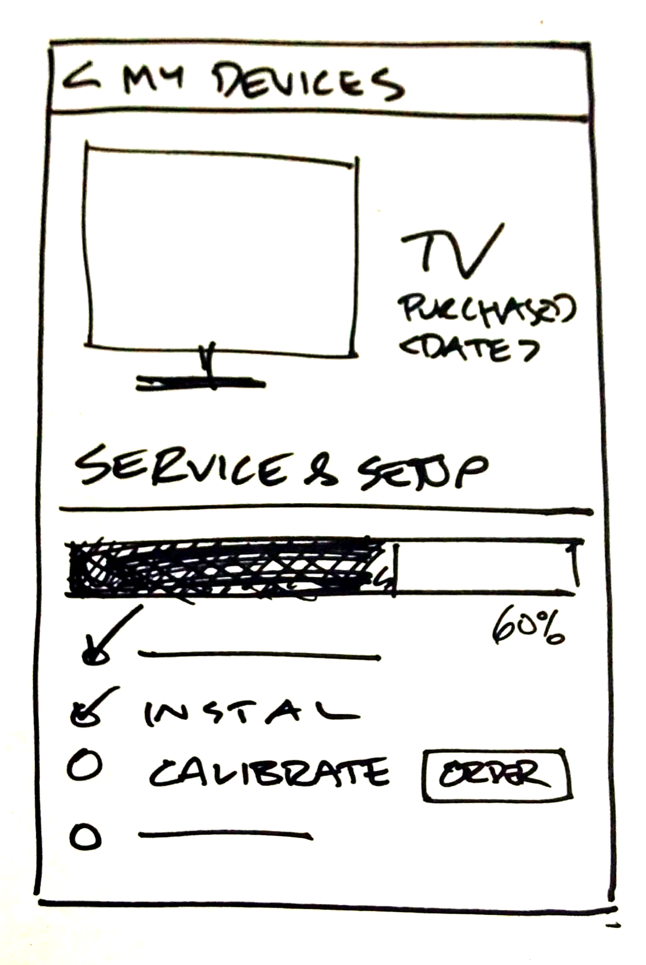
SERVICE UX THEMES
PROVIDE A PLAN
After the service (or purchase) communicate a sense of accomplishment, as well as outlying possible next steps.
Next steps can be a mixture of paid services, free member perks, or free content that allows customers to extend the capability of their purchase.
Notes:
- Purchase story

Slide 26
SERVICE UX THEMES
PROVIDE A PLAN
PROVIDE A PLAN
Breakdown all available services into a progression so that there is always a simple next step
Create a sense of accomplishment and completion for rendered services
Instill a sense ‘getting the most out of your device’ in the Tech Enthusiast
Communicate steps of rendering services clearly
Notes:
Break down service offer, give next steps
Some services are free

Slide 27
MAPPING THEME EXAMPLES TO CUSTOMER JOURNEY

Slide 28
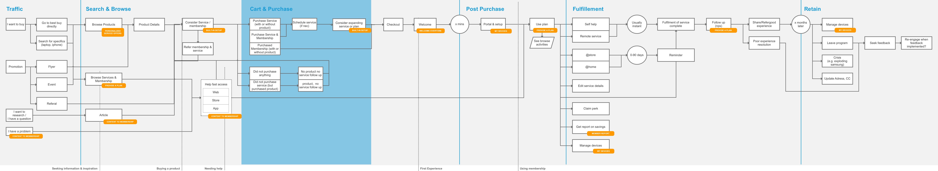
Notes:
Orange pill

Slide 33
SPRINT USER TESTING RESULTS

Slide 34
SPRINT USER TESTING RESULTS
Key questions
Where should we place GSHM information (banner) through the purchase flow?
Do users understand the GSHM offering?
What are their expectations around this service?
Notes:
Do users notice the GS service during their purchase flow? Are users most likely to notice it on category page, PDP, or cart? Where do they prefer to see it?
Methodology:
We invited 5 participants (2 externals, 3 internals) to Best Buy office on May 12th, for 60 minute, 1-on-1, in-person sessions.
Method: semi-structured interview scenario based testing.
Stimulus: online prototype
Scenarios: buying a laptop, looking for help setting up a laptop
Limitations: we only tested scenarios around laptop buying setting-up. For other scenarios or products results may have been different. Due to last minute cancellations from external participants, we interviewed 3 internal participants

Slide 35
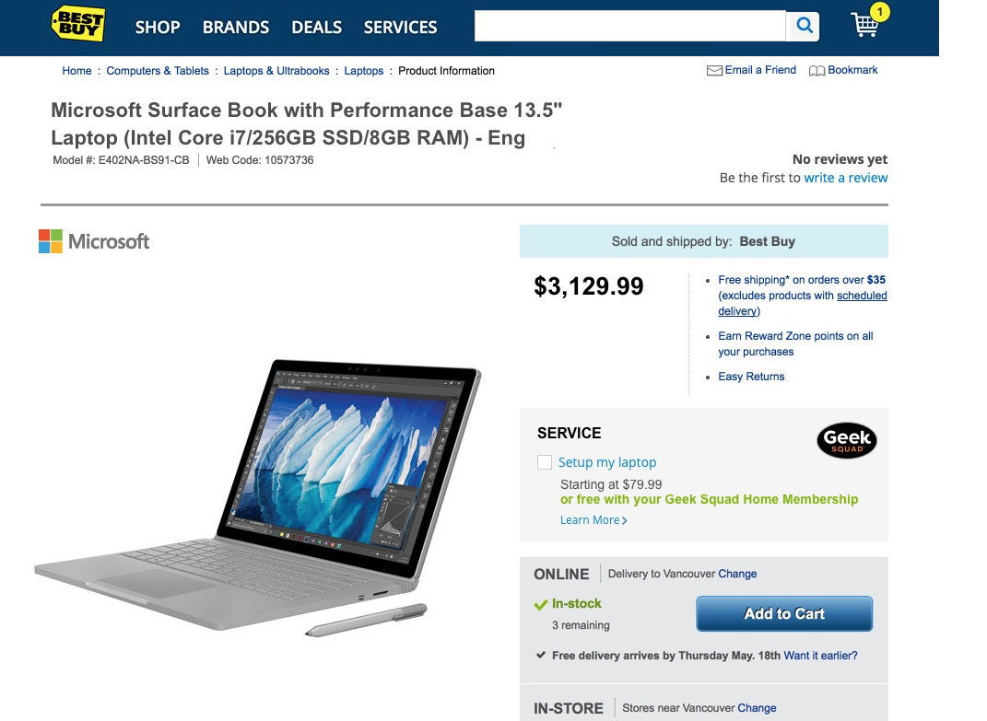
SPRINT USER TESTING RESULTS
NOTICING DURING PURCHASE
Do users notice the GS service during purchase?
Notes:
When buying a laptop users looked for price, features and specs (some had trouble finding the specs), and shipping/store information.
Users did not notice GS during their purchase flow for the scenario tested (even though some of them were familiar with the GS program). One user noticed it in cart.
Set-up help when buying a laptop did not provide enough value for them, as most set up their computer by themselves.
Set up is a vague term, different users understand it differently, but they typically think of the basic set-up, and do not think of all the services included in GS set-up.
It is more likely for users to look for help when they have a problem with the computer

Slide 36
SPRINT USER TESTING RESULTS
NOTICING DURING PURCHASE
Findings
Recommendations
Users did not notice GS during their purchase flow for the scenario tested. One user (of five) noticed it in cart.
Set-up help when buying a laptop did not provide enough value for them. Different users understand it differently, but they typically think of the basic set-up, and do not think of all the services included in GS set-up.
Revisit placement of GSHM in purchase flow
Present specific perks of membership (e.g., tech support, virus removal, what set-up really includes)
Inform users that they can subscribe any time
Notes:
When buying a laptop users looked for price, features and specs (some had trouble finding the specs), and shipping/store information.

Slide 37
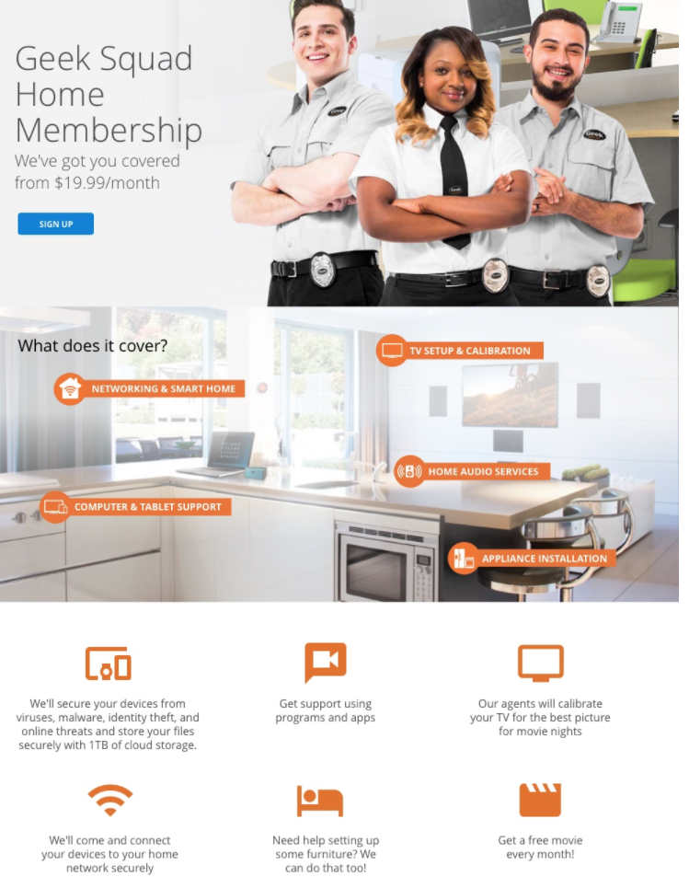
SPRINT USER TESTING RESULTS
UNDERSTANDING THE PROGRAM
Do users understand the GSHM offering?

Slide 38
SPRINT USER TESTING RESULTS
UNDERSTANDING THE PROGRAM
Findings
Recommendations
After being directed to read the benefits, they were positive about the all-inclusive nature of offering.
Users needed for more information about what is included in the plan
Regular service pricing schemes with in-home and in-store options caused confusion
Clearly present all plans, benefits, options and pricing. Users expect a high-level overview, and want the ability to get detailed description all options and benefits.
Categorize options based on user needs (rather than internal GS groups)
Consider simplifying the GS offerings.
Notes:
What is actually included, when they can become members, is GSMH tied to specific products or purchases?
Users did not know what services to expect for other devices they own, furniture installation.
“ Tell me it’s Included, regardless of purchase time or source”

Slide 39
What are their expectations around this service?
Users expected to be able to get timely help from GS agents through different channels.
Expectations around self-help portal: Since users pay for the service, they expect to get help from GS members in-person, on phone or online, and are less willing to look for self-help resources.

Slide 40
NEXT STEPS

Slide 41
NEXT STEPS
Minimum Viable Iteration Mini Sprint
Use learning from first sprint, especially content findings (May 29 – 31)
Provide solution for selling services starting with only TV category
Revisit placement of GSHM in flow
Prioritize resources to focus on design/development/improvement of this project
Find moment of truth where customers are most likely to consider GSHM: After adding to cart? After purchase?
Find a means to test with real customers
Notes:
Other questoins
Is there a way to simply test chat?
Test interest in savings as expression of time
Test interest in device auto-setup reaction
Test re-engagement
Iteration 2: Re-use prototype and perform a quick follow up test

Slide 42
INTRODUCTIONS
Thank you to all who pitched in!
Full-time participants: Angelo Daga, Angel Yeh, Andrew Wong, Laura Buchanan, Antek Wodzynski, Philip Yee, Jason Joo
Part-time participants: Sara Aghvami , Ashley Sims, Emma Speakmann, Mike Leahy, Mihaela Zahariev
Experts: James Pelletier, Erin Isberg, Katherine Cumming, Michelle Yuen, Cliff Stefanuk, Jeff Moger, Kaya Rosenbloom, Manveer Gill
Test Participants: Have to remain anonymous, but we are thankful

Slide 43
APPENDIX

